Slide 1
Autonomous Robot with STM32F407 for Maze Navigation
ROBOT MAZE STM32F407 | Aqualix Slayers | Politehnica University of Timisoara

Slide 2

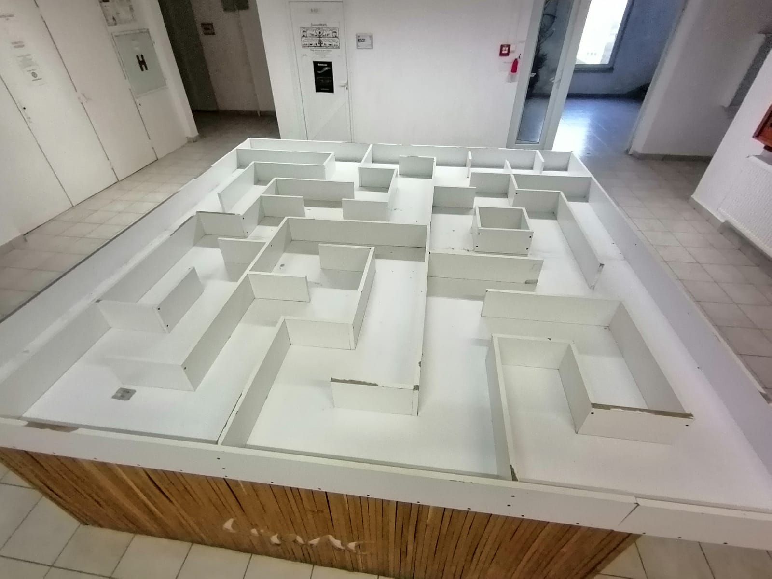
Project Objective
Design and programming of an autonomous robot.
Navigation through a maze without external control.
Using STM32 + sensors + simple decision algorithm.

Slide 3
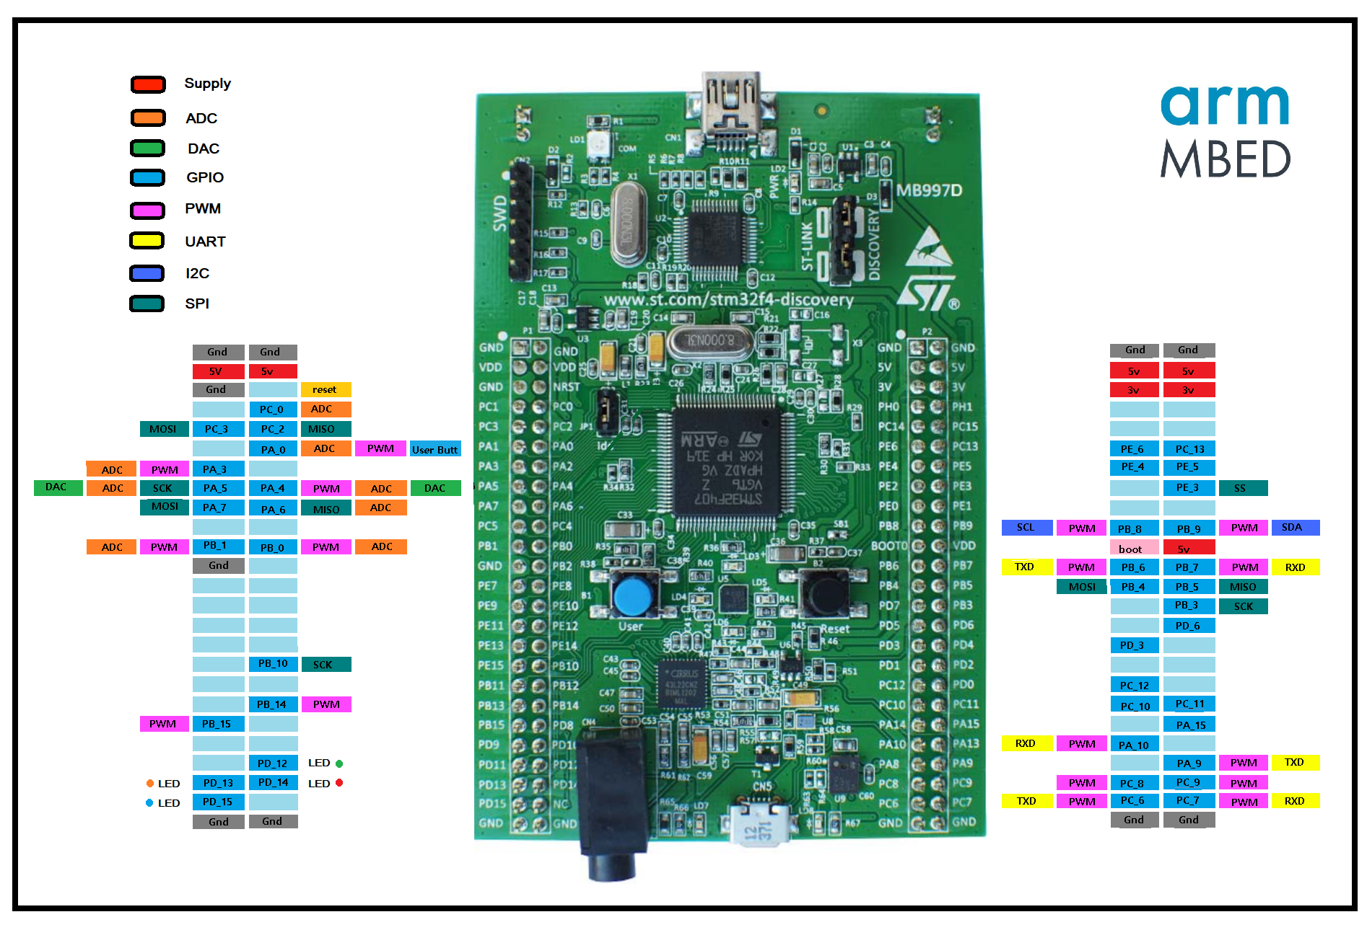
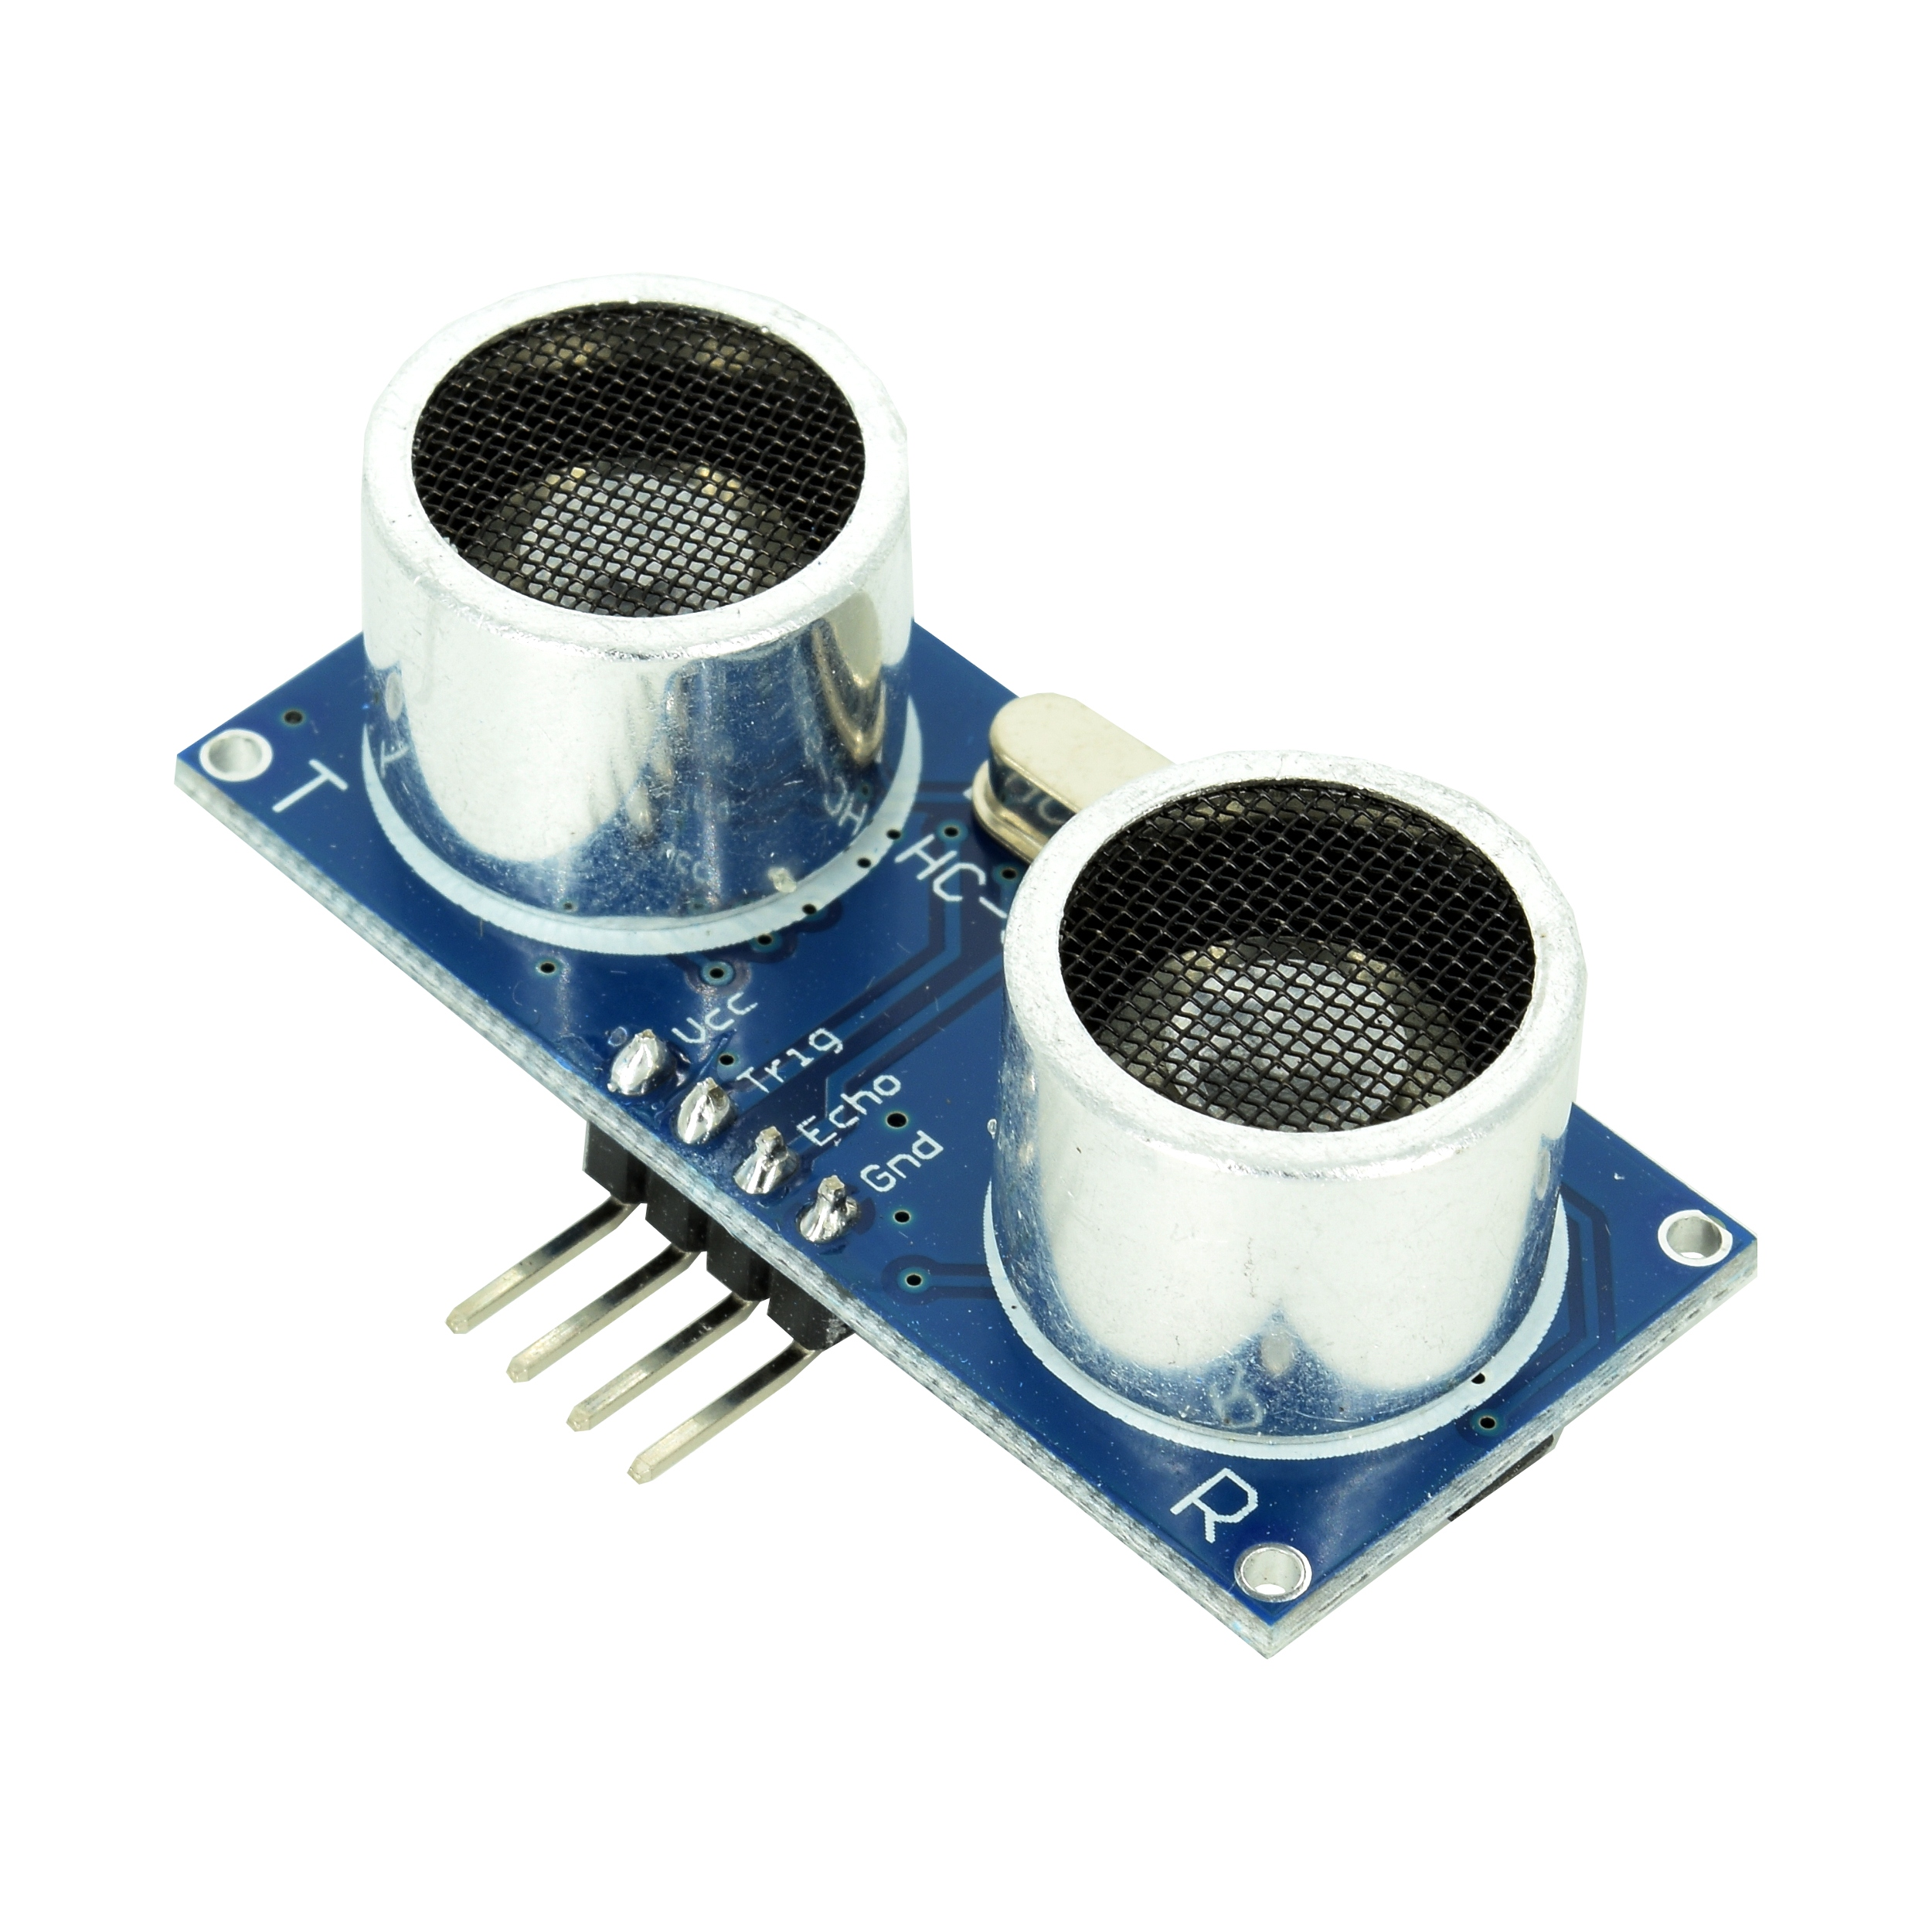
Hardware Components
STM32F407G-DISC1
DC motors + L298N driver
Robot platform + LiPo battery
HC-SR04 sensors

Slide 4
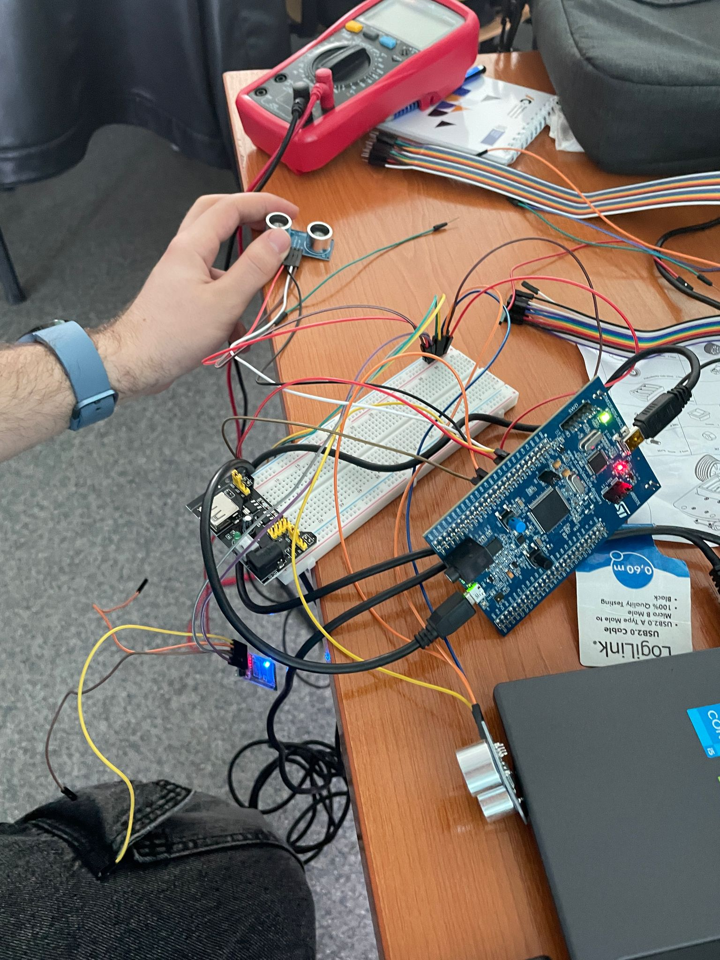
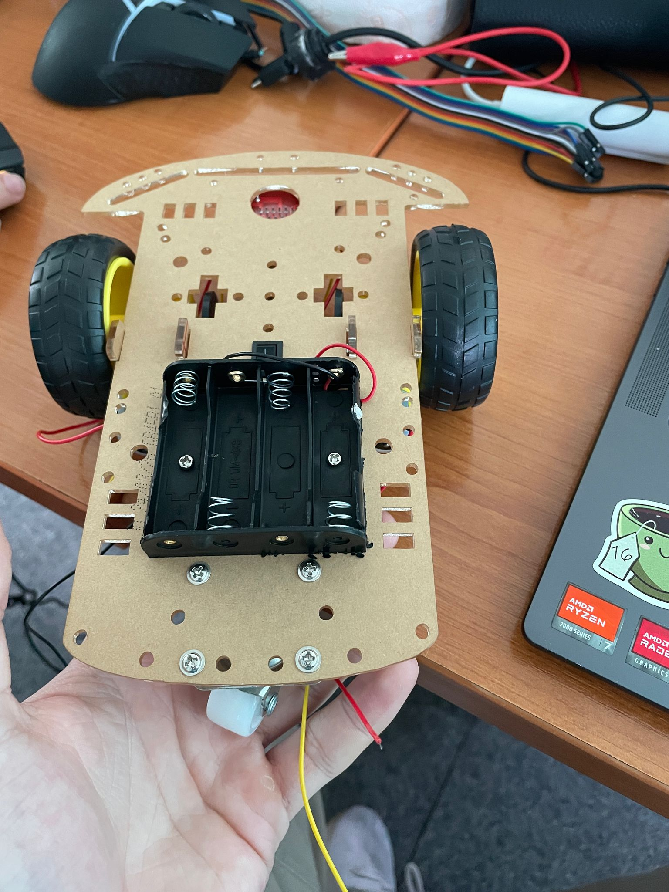
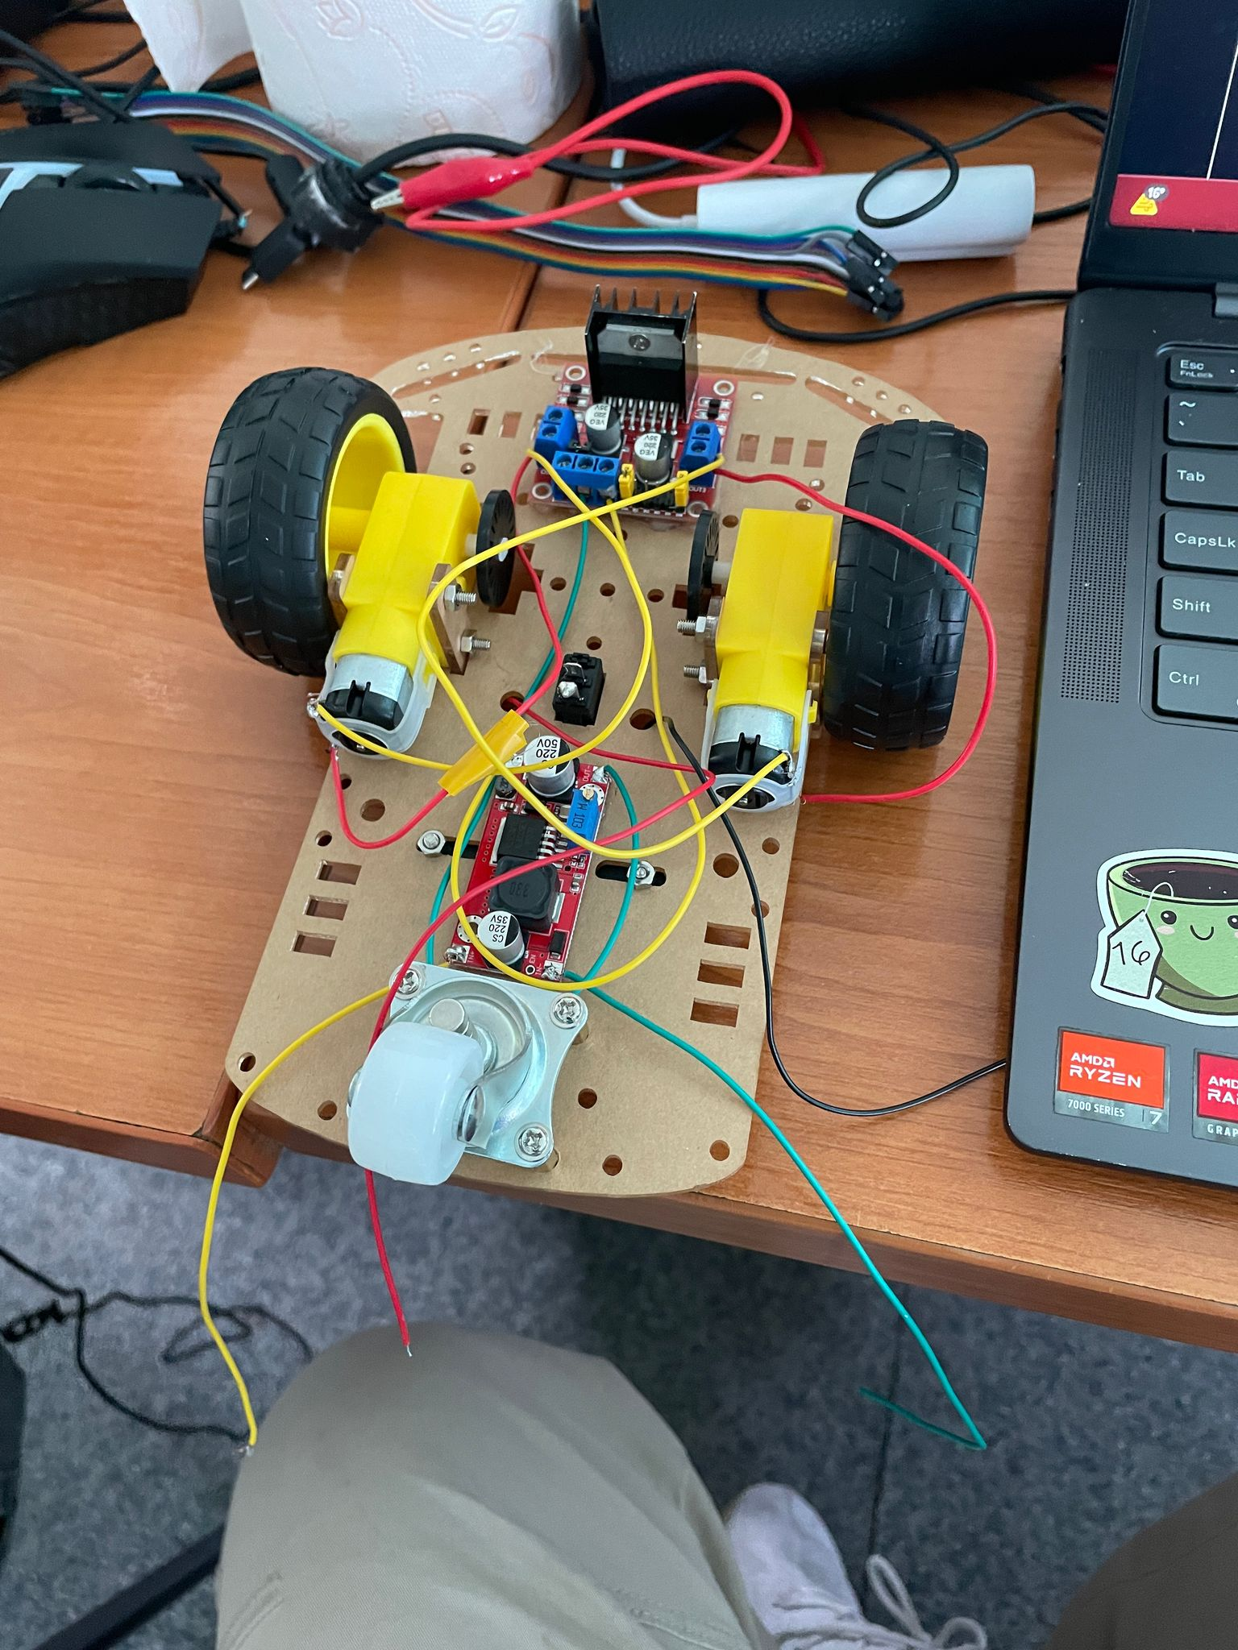
System Architecture
Sensors → STM32 → Motors
Data reading via ADC / GPIO
Motor control using PWM (TIMx)

Slide 5
Navigation Algorithm
Algorithm: wall-following (left-wall tracking)
Decisions based on sensor readings
Obstacle avoidance and maze exit search

Slide 6
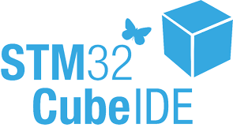
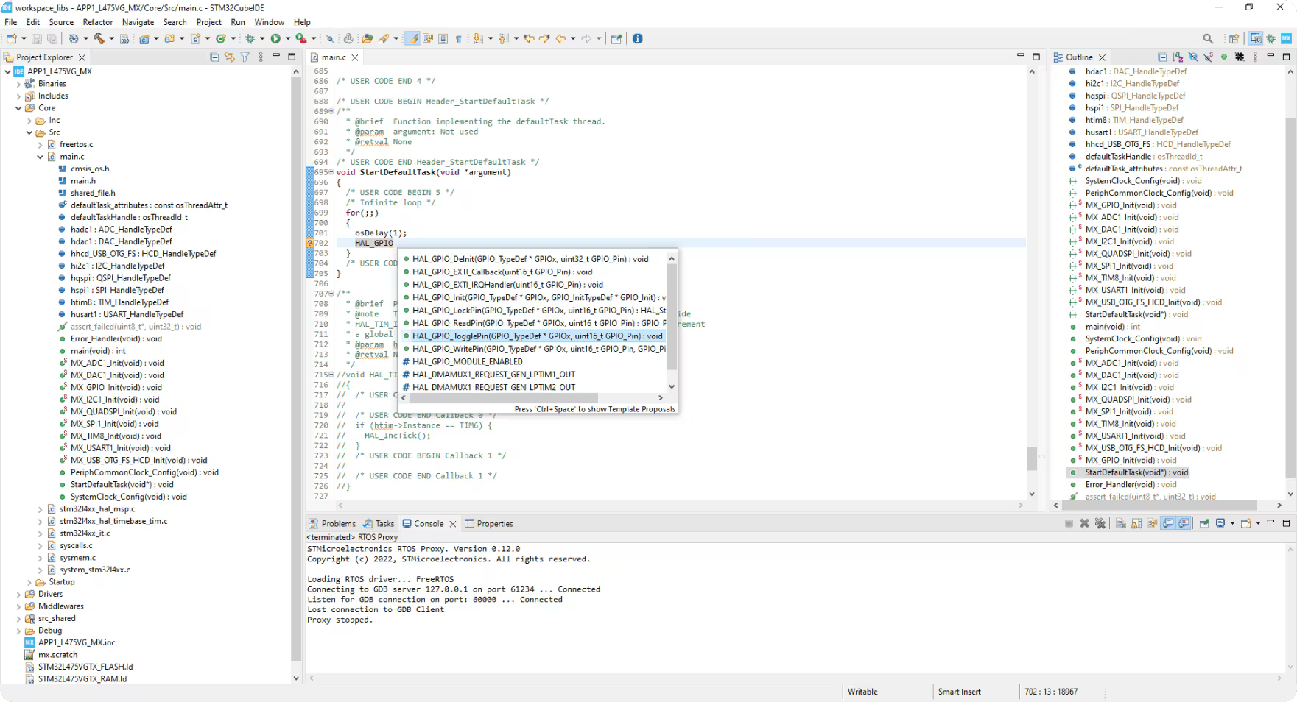
Software
Language: C, using STM32CubeIDE
Modules: sensors.c, motors.c, navigation.c
Features: PWM, ADC, GPIO, Timers

Slide 7
Conclusion
STM32 robot autonomously navigates a maze.
Complete hardware + software integration.
Solid foundation for more complex projects.

